Slide 1
Docker for Web Developer PART-3
By: Hardik Raval

Slide 2
Docker Compose (Compose) - Introduction
Docker Compose is a tool for defining and running multi-container Docker applications. With Docker Compose, you use a YAML (docker-compose.yml) file to configure your application's services.
For Mac and Windows, Docker Compose is included as part of those desktop installs.
On Linux systems, Docker Compose has to be installed separately.

Slide 3
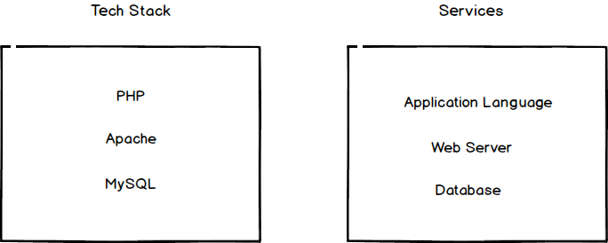
Services in Docker Compose

Slide 4
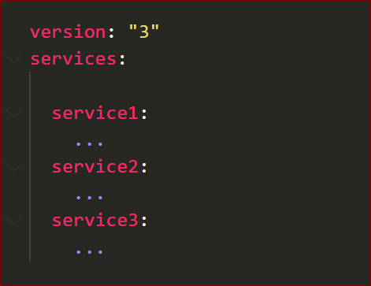
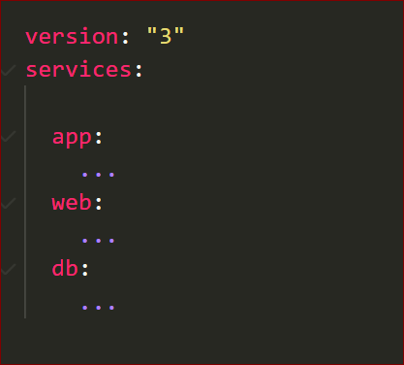
Compose file structure

Slide 5
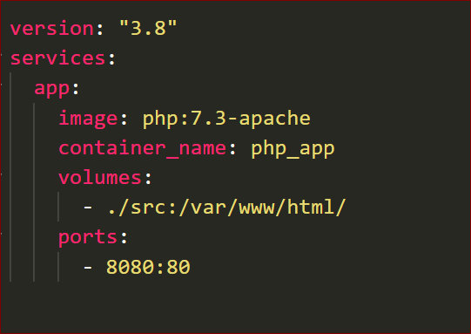
Build Compose file – Example #1

Slide 6
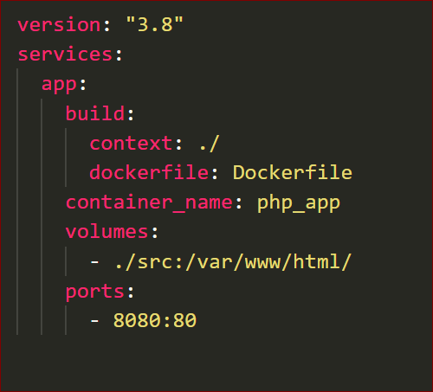
Build Compose file – Example #2

Slide 7
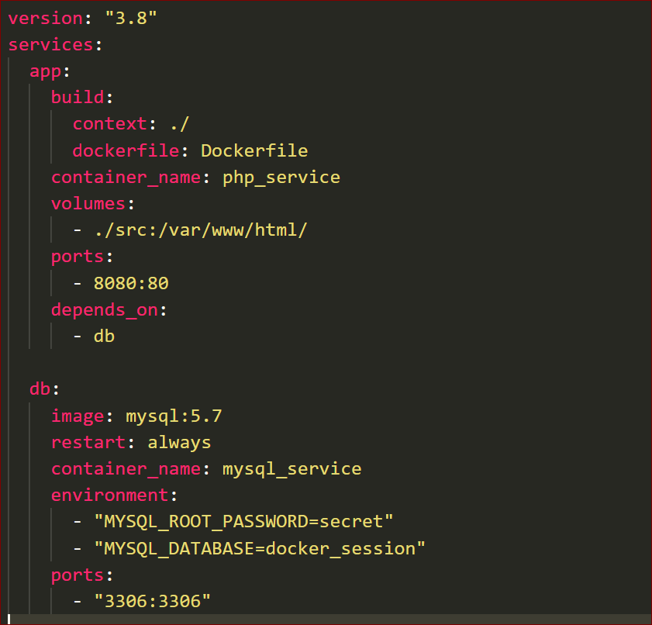
Build Compose file – Example #3

Slide 8
Build Compose file – Example #3
Thank you!

